Slide 1

12 – FOSS Project Structures and the FarmData2 Community
COMP 190 – Dickinson College
Fall 2021

Slide 2
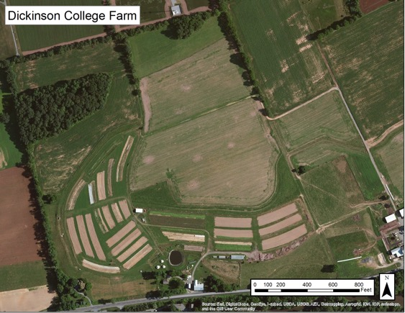
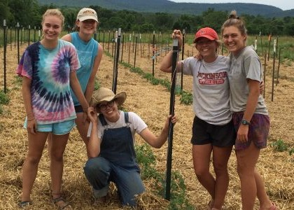
The Dickinson Farm
Dickinson’s College Farm is an 80-acre, USDA-certified organic farm and a living laboratory where students can gain distinctive, hands-on learning experiences.

Slide 3
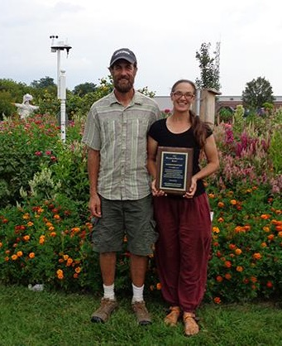
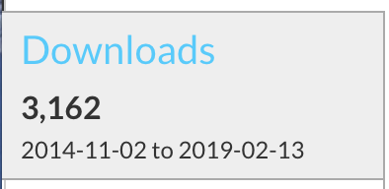
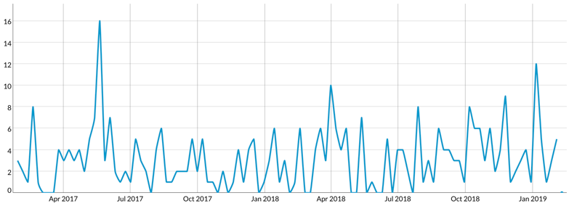
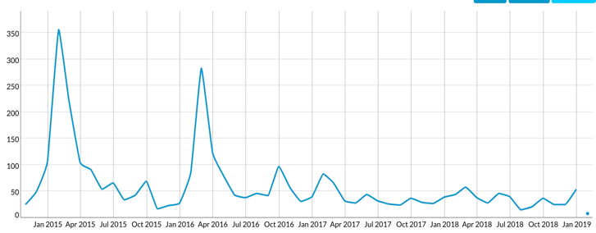
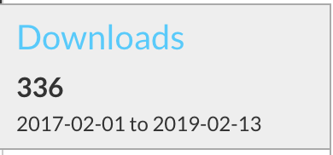
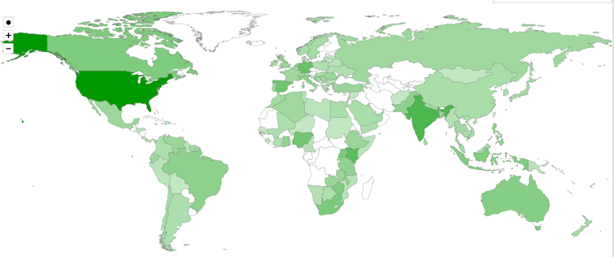
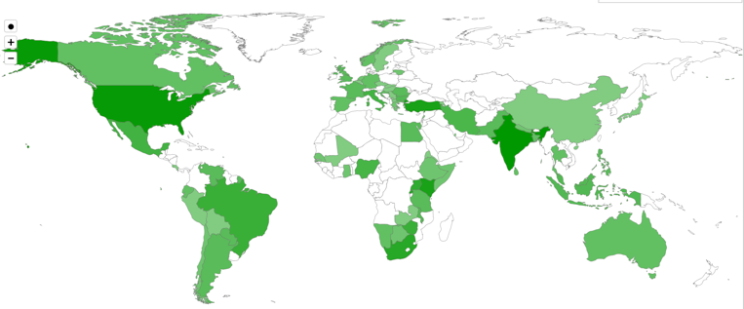
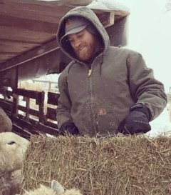
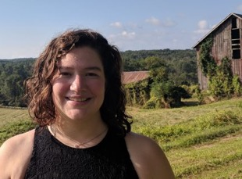
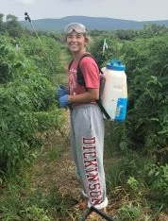
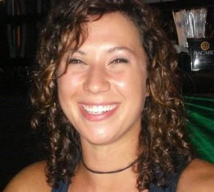
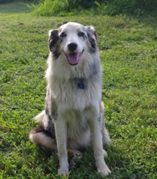
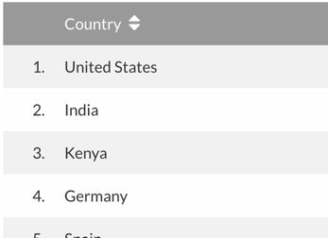
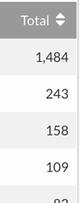
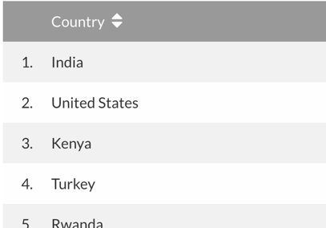
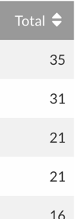
Local Clients, Global Communities
FarmData
AnimalData
Notes:
A little dated…. 2019
Matt (Farmer) & Jenn (Farm Manager)

Slide 4
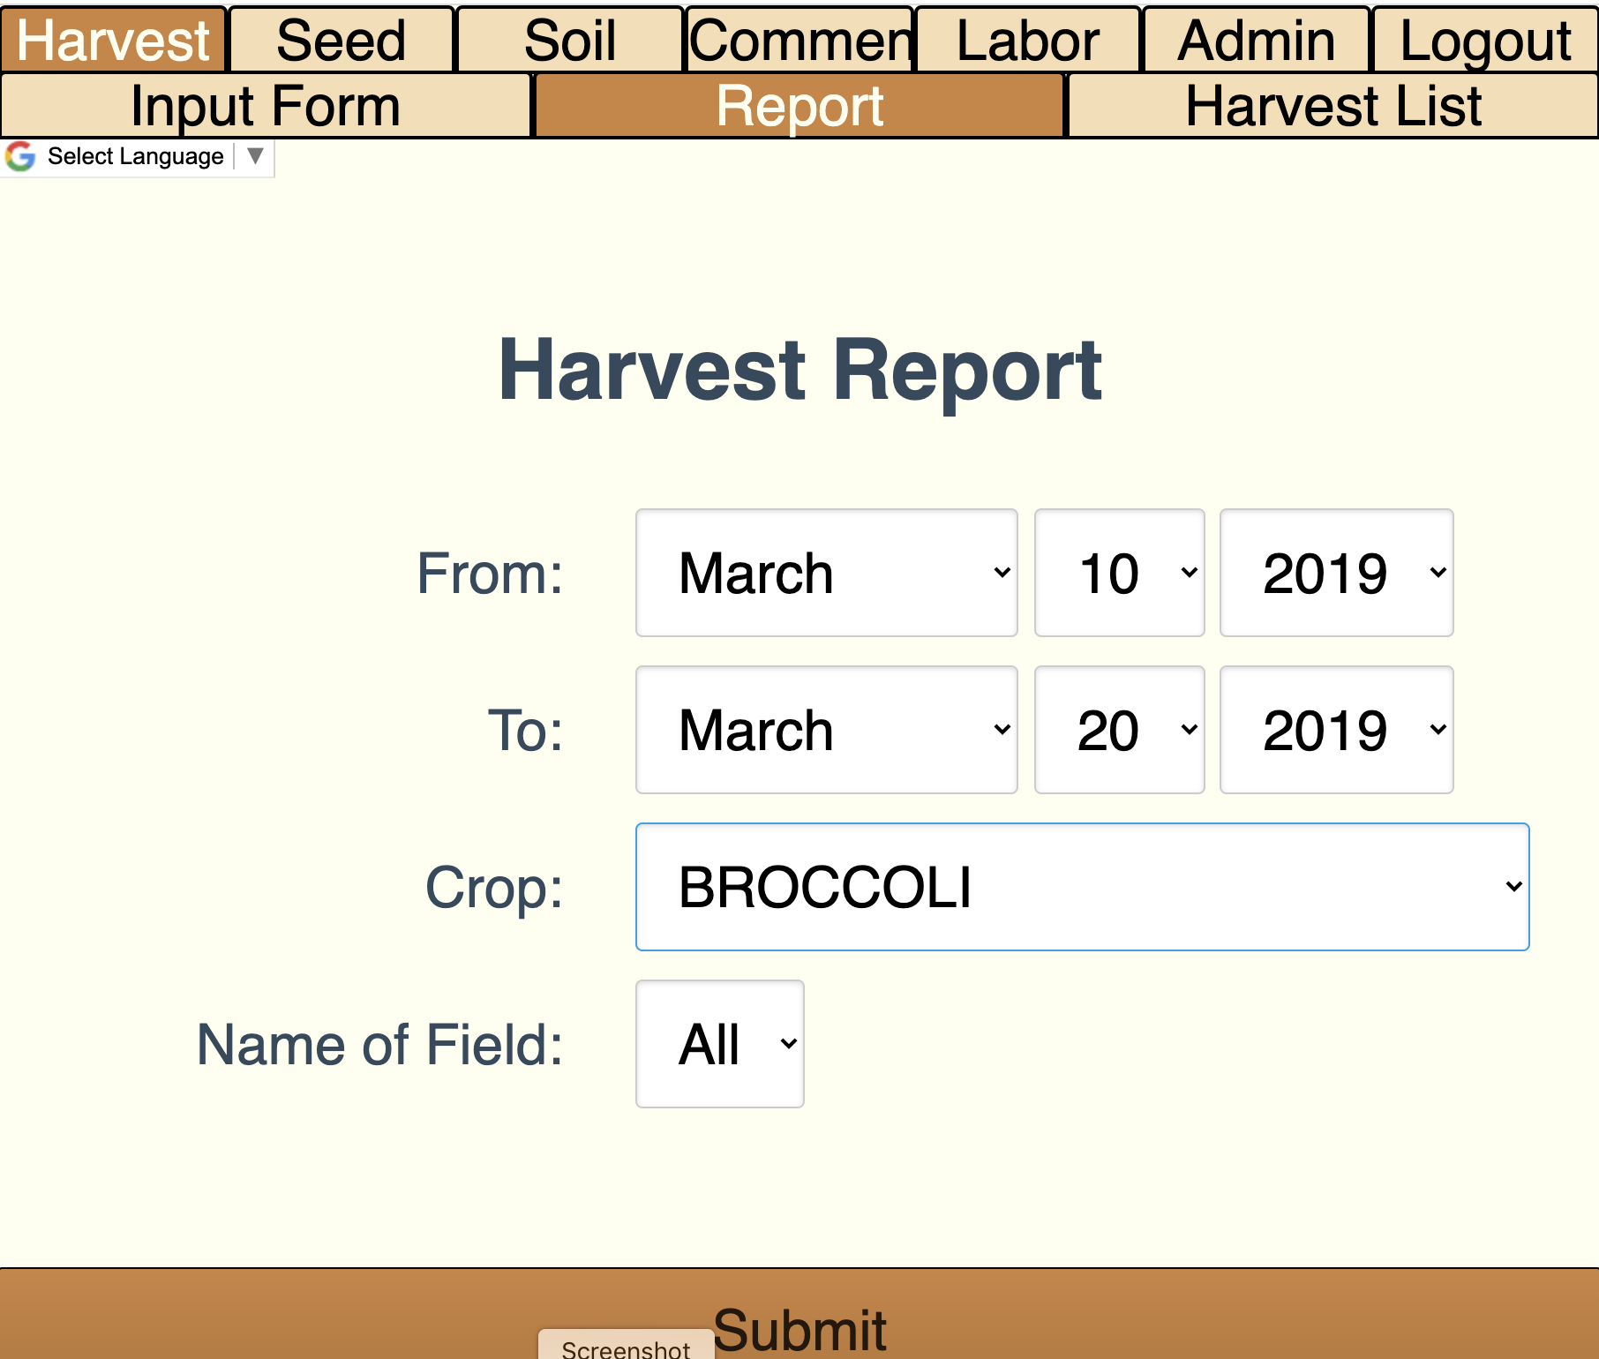
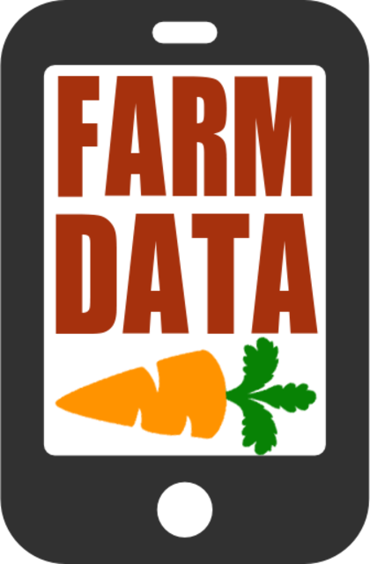
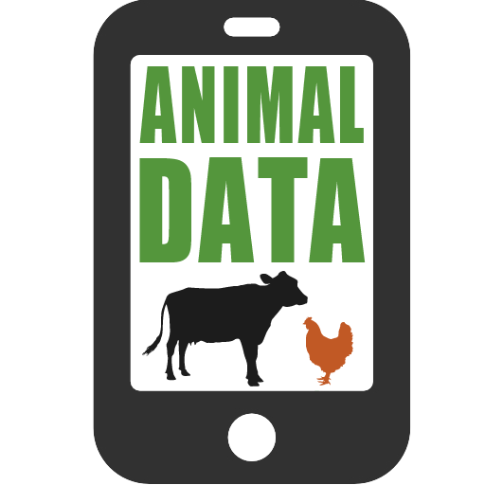
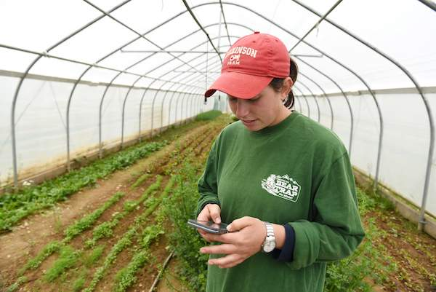
FarmData & AnimalData
Notes:
2011 collaboration between Prof. Tim Wahls and Matt Steiman at the College Farm
Over 5 years
Led to the development of two applications
Used in the field on mobile devices to record data about harvests, growth, pest control, and a host of other things
Used in the barn on desktop machines to plan harvests, track inventory and sales and to maintain records for organic certification.
2016 – We lost Tim to cancer
Development of FarmData and AnimalData stopped.
But interest from the College Farm and other farms that are also using the FarmData app has remained.

Slide 5
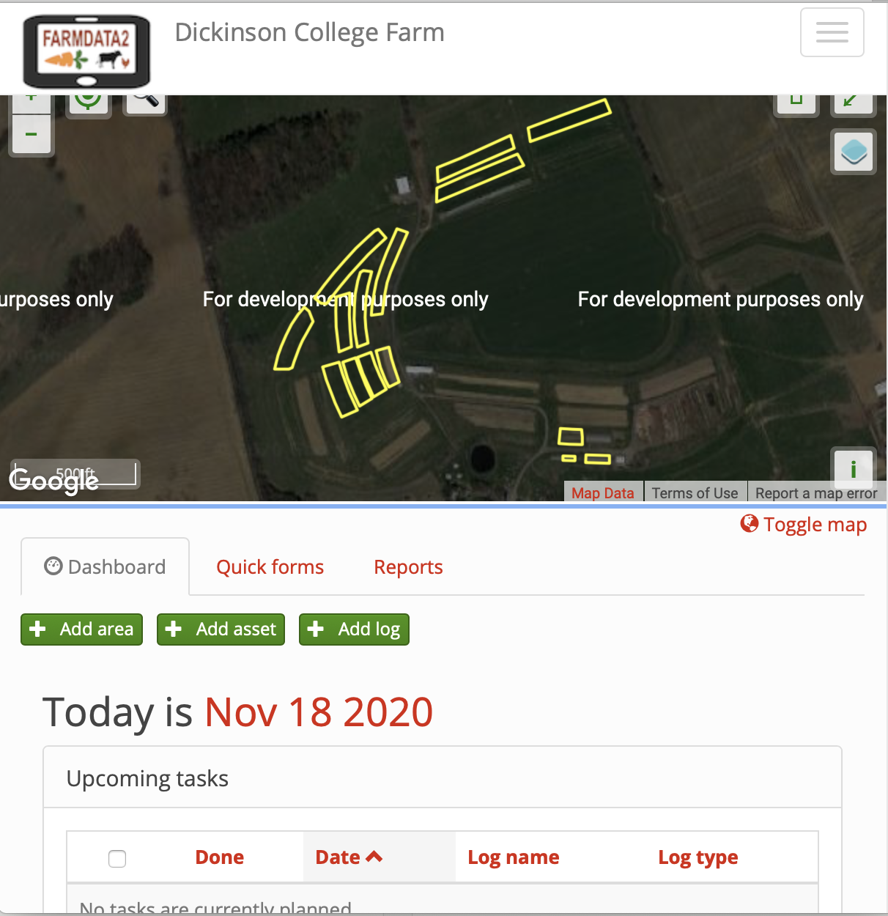
FarmData2
FarmData2 updates and combines FarmData and AnimalData, combining them into a single application that supports the operation and certification requirements for small organic farming operations.
A living FOSS project and community
Notes:
So the CS department has been working on launching the FarmData2 FOSS project
In conjunction with the curriculum redesign that began to roll out in Fall 2019.
COMP 130, this class and COMP 290 are a big part of that redesign.

Slide 6



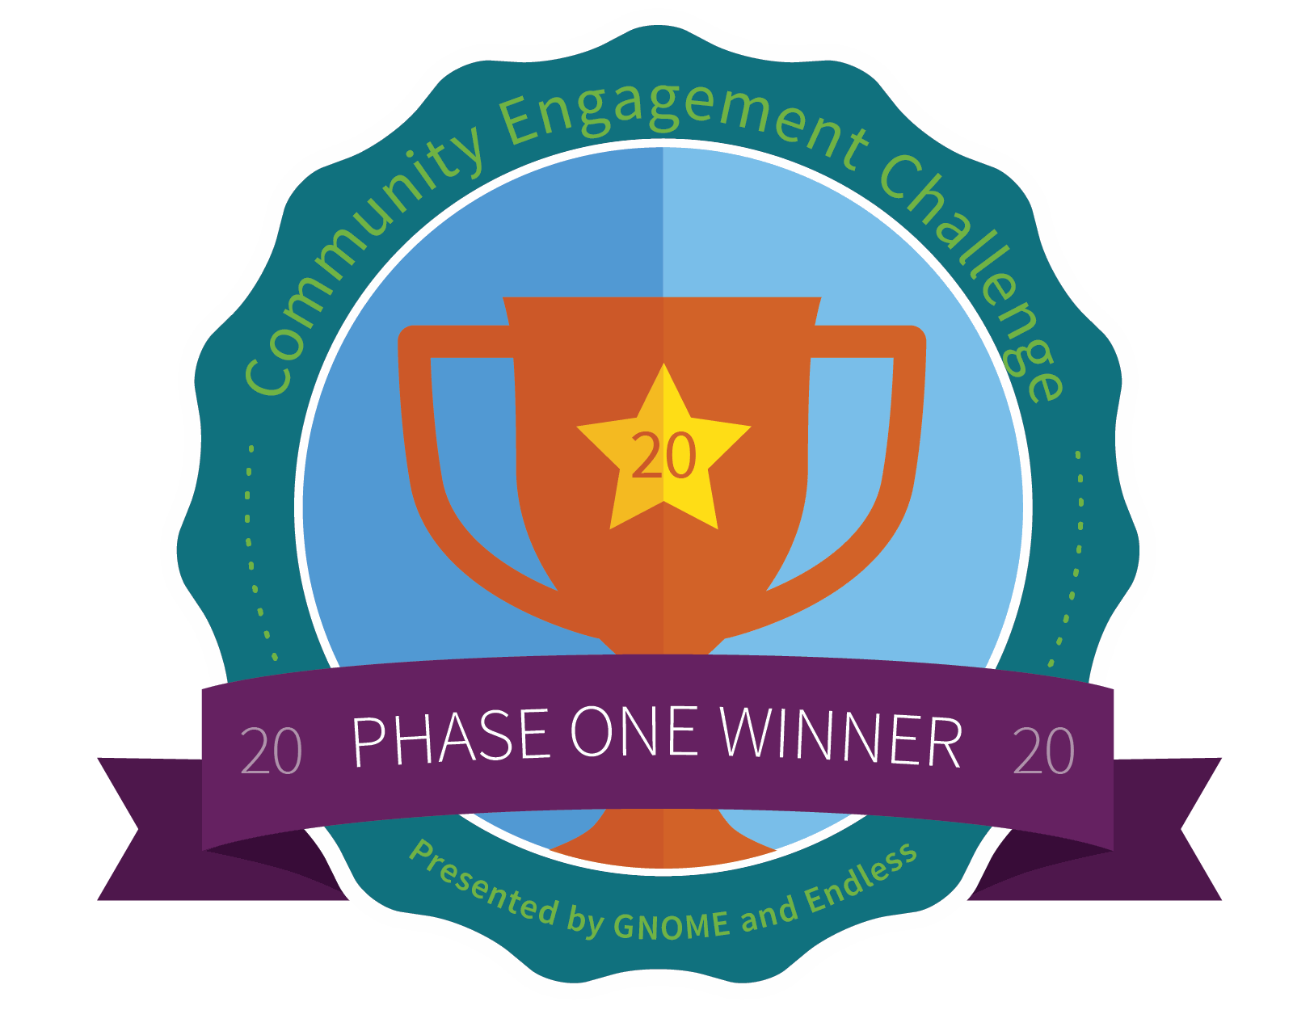

FarmData2 and Dickinson CS
The FarmData2 project and community provide a real-world FOSS platform for authentic experiences in COMP 190 and COMP 290.
Develop skills, knowledge and experiences for success in the senior seminar (COMP 491/492) with FOSS “in the wild” and beyond Dickinson’s limestone walls.
Connect computing with Dickinson’s mission of an “education in service to the common good”
Our approach has received recognition and support from:
The Non-Profit FOSS Institute (NPFI)
Software Freedom Conservancy (SFC)
National Science Foundation (NSF)
The GNOME Foundation
Notes:
Skills and experiences that will give you an advantage in
NPFI – development expertise and support – building engagement with courses at other institutions.
SFC – supporting development and dissemination of course materials developed here
NSF – where development of FarmData2, and 190/290/491/491 are part of 5-year $1.9M project looking at using humanitarian foss in the CS curriculum.
- drexel university, western new England college, Worcester State University, Nassau Community College
GNOME – FarmData and the use of FOSS in the Dickinson Curriculum selected from 160 international projects a winner in the GNOME Community Engagement challenge for its efforts to broaden participation in computer science through engagement with FOSS with a humanitarian focus.

Slide 7
Activities
Explore a number of Humanitarian FOSS (HFOSS) projects.
Investigate one of interest in more depth.
Learn about and observe the common structures shared by FOSS projects.
In an HFOSS project of interest
In FarmData2
Critically evaluate those structures in FarmData2 to help improve it.
Join the FarmData2 community.

Slide 8
What’s Next?
A12/Q12 – 1 week
Revise and resubmits
Reading for discussion

Slide 9

Acknowledgments:
Slide Template From:
https://creativecommons.org/licenses/by/4.0/
Slide Content Licensed as:
https://creativecommons.org/licenses/by-nc/4.0/

